Slide 1
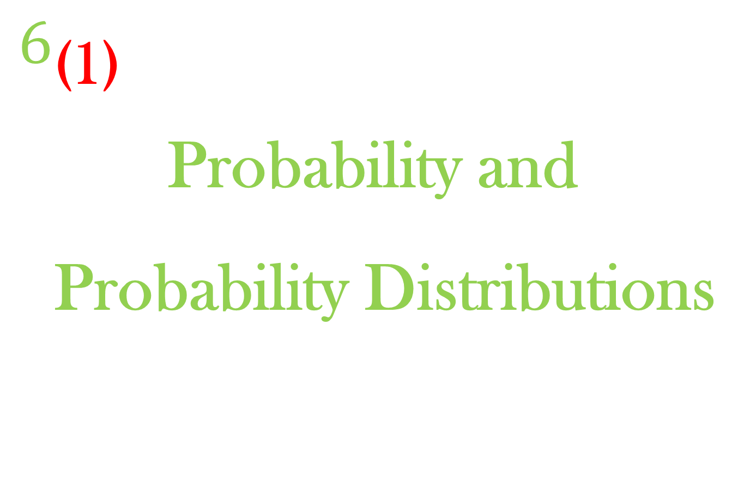
$$6_{\text{(}\text{1}\text{)}}$$
Probability and Probability Distributions

Slide 2
Introduction to Probability

Slide 3
6.1
Definitions of terms

Slide 4
6.1 Introduction to Probability (Definition of terms)
Definition 1:- In statistics, any process of observation or measurement is called an experiment.
Example 1: i. To count the number of times a head appears on top in tossing a coin five times.
ii. To identify the number of defective items from a set of items.

Slide 5




6.1 Introduction to Probability. (Definition of terms)(Contd. . . .)
Tossing a coin

Slide 6

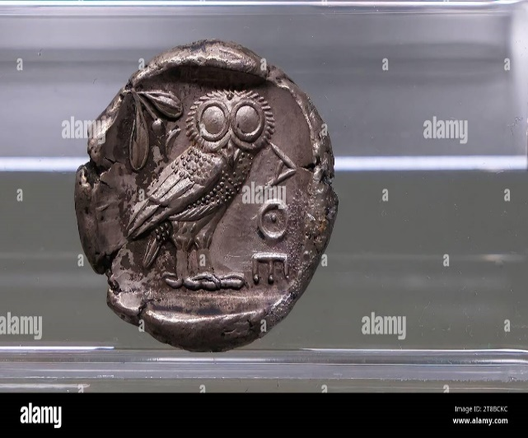
6.1 Introduction to Probability Definition of terms(Contd. . . .)
Head Tail
The terms "heads" and "tails" on coins originated from the images on ancient coins and the terminology used in games of chance: The front of Athenian coins featured the head of Athena, and the back featured her sacred animal, the owl, with its tail hanging down.

Slide 7
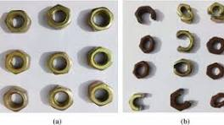
6.1 Introduction to Probability (Definition of terms)

Slide 8


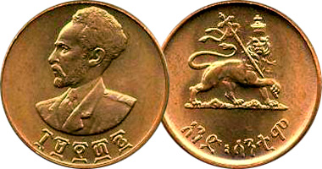
6.1 Introduction to Probability Definition of terms(Contd. . . .)

Slide 9
6.1 Introduction to Probability Definition of terms (Contd. . . .)
Definition 2:- The result we obtained from an experiment are called outcomes.
Example 2:- i. Count the total number of times a head appears on top in tossing a coin three times. Here the possible outcomes are 0, 1, 2, 3.

Slide 10

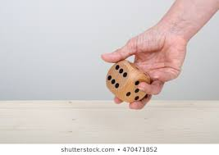
6.1 Introduction to Probability Definition of terms (Contd. . . .)
ii. Roll a die once and observe the numbers that turns on top. Here the possible outcomes are 1, 2, 3, 4, 5, 6.
Rolling a die

Slide 11
6.1 Introduction to Probability Definition of terms (Contd. . . .)
Definition 3:- The set of all possible outcomes is called a sample space and is denoted by S.
Example 3:- i. Consider example 1(i) of definition 1. The sample space is S = { H, T}
ii. Consider example 1(ii) of definition 1. What is the sample space?

Slide 12
6.1 Introduction to Probability Definition of terms (Contd. . . .)
iii. Consider example 2(ii) of definition 2. What is the sample space?
Definition 4:- Any subset of the sample space is called an event.
Example 4:- Consider example 2(i). We have the following events for S = {0, 1, 2, 3}.

Slide 13
6.1 Introduction to Probability Definition of terms (Contd. . . .)
Let A: The number of heads is greater than 1. i.e. A = {2, 3}.
B: The number of heads is less than 3.
i.e. B = {0, 1, 2}
C: No head turns on top.
i.e. C = {0}

Slide 14
6.1 Introduction to Probability Definition of terms (Contd. . . .)
Definition 5:- Two events are said to be mutually exclusive if they cannot both occur at the same time.
Example 5:- i. Consider an experiment of rolling a die once. Define events A and B as:

Slide 15

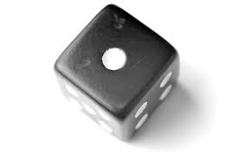
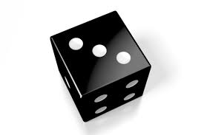

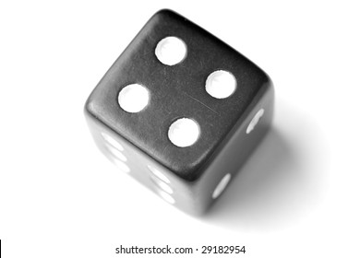

6.1 Introduction to Probability Definition of terms (Contd. . . .)
A: an odd number turns on top
i.e., A = {1, 3, 5}.
B: an even number turns on top
i.e., B = {2, 4, 6}.
Thus A ∩ B = ∅, and hence by definition A and B are mutually exclusive events.

Slide 16
6.1 Introduction to Probability Definition of terms (Contd. . . .)
ii. Consider again an experiment of rolling a die once. Define an event C as:
C: a number less than 3 turns on top = {1, 2}
Then neither A and C nor B and C are mutually exclusive events since A ∩ C ≠ ∅ and B ∩ C ≠ ∅.

Slide 17



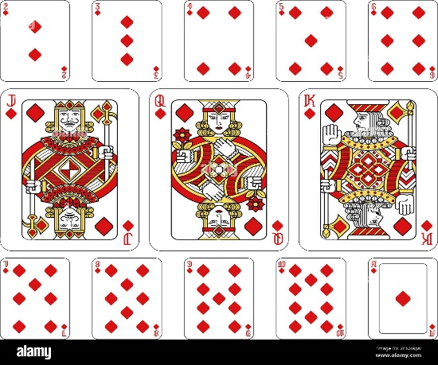
6.1 Introduction to Probability Definition of terms (Contd. . . .)
iii. Consider an experiment of drawing a card once from a well shuffled ordinary deck of 52 cards. Define events A, B, and C as:
A: The drawn card is a Jack.
B: The drawn card is a King.
C: The drawn card is a red card.

Slide 18


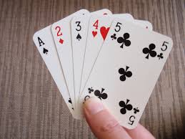



6.1 Introduction to Probability Definition of terms (Contd. . . .)

Slide 19




6.1 Introduction to Probability Definition of terms (Contd. . . .)

Slide 20
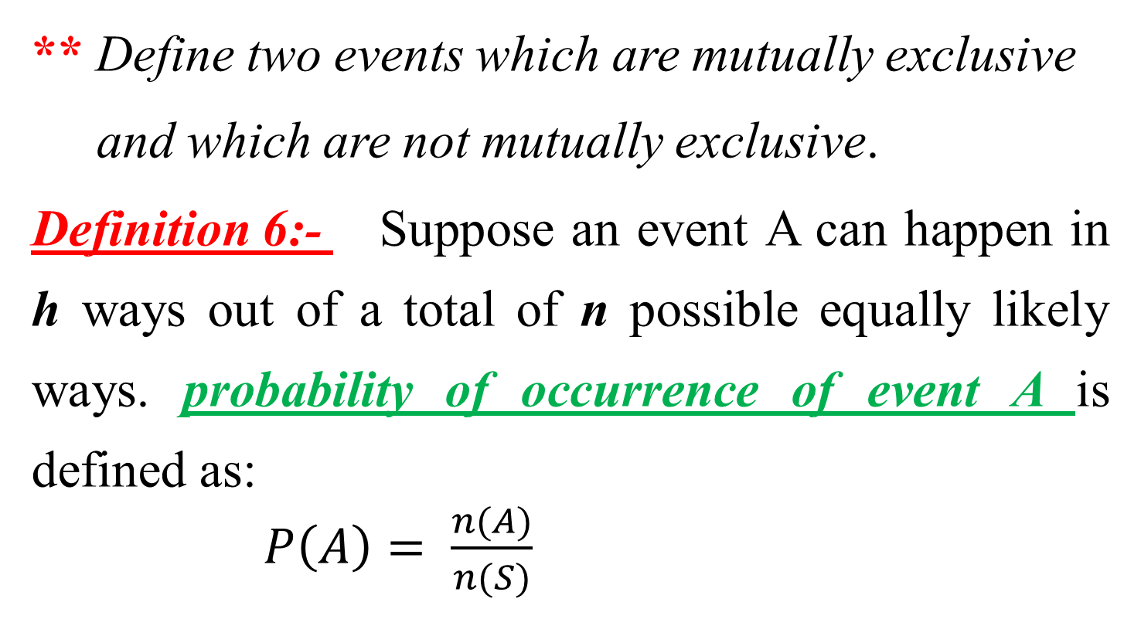
6.1 Introduction to Probability: Definition of terms (Contd. . . .)
** Define two events which are mutually exclusive and which are not mutually exclusive.
Definition 6:- Suppose an event A can happen in h ways out of a total of n possible equally likely ways. probability of occurrence of event A is defined as:
$P\left(A\right)= \frac{n(A)}{n(S)}$

Slide 21
6.1 Introduction to Probability: Definition of terms (Contd. . . .)
Example 6:- Consider an experiment of rolling a die once. What is the probability of getting
(i) a 5? (ii) an odd number?
(iii) a 1 or a 4? (iv) a 7?

Slide 22
6.2
Postulates of probability

Slide 23
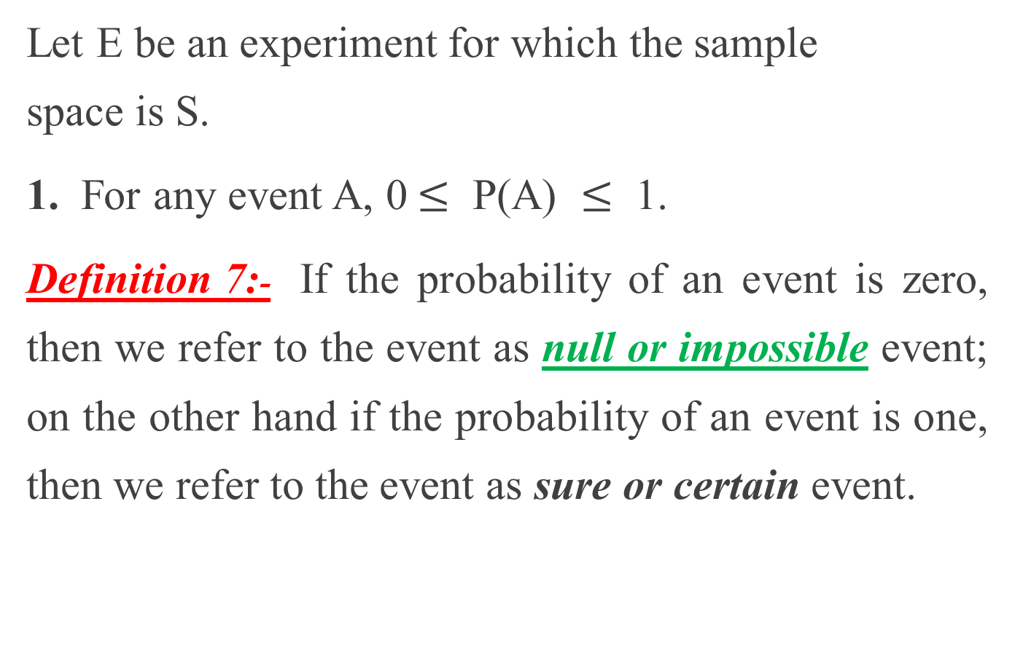
6.1 Introduction to Probability: Postulates of Probability
Let E be an experiment for which the sample space is S.
1. For any event A, 0$≤$ P(A) $≤$ 1.
Definition 7:- If the probability of an event is zero, then we refer to the event as null or impossible event; on the other hand if the probability of an event is one, then we refer to the event as sure or certain event.

Slide 24
6.1 Introduction to Probability: Postulates of Probability
2. P(S) = 1.
3. Addition Rule For Two Mutually Exclusive Events.
If A and B are two mutually exclusive events, then P(A or B) = P(A ∪ B) = P(A) + P(B).

Slide 25
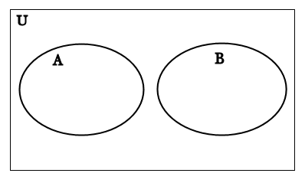
6.1 Introduction to Probability: Postulates of Probability
Disjoint sets or Mutually Exclusive events:-
A ∩ B = ∅

Slide 26
6.1 Introduction to Probability: Postulates of Probability
4. Addition Rule for two events that are not Mutually Exclusive.
If A and B are not mutually exclusive events, then P(A or B) = P(A) + P(B) – P(A and B)
OR P(A ∪ B) = P(A) + P(B) – P(A ∩ B).

Slide 27


6.1 Introduction to Probability: Postulates of Probability
Non disjoint sets or Non Mutually Exclusive Events:-
A ∩ B ≠ ∅
U

Slide 28
6.1 Introduction to Probability Postulates of Probability
Example 7:- A card is drawn from a well shuffled ordinary deck of 52 cards. What is the probability that the drawn card is:
(i) a Queen or a Jack?
(ii) a Queen or a black card?
(iii) a face (picture) card or a red card
(iv) a picture card or a diamond?

Slide 29
6.1 Introduction to Probability Postulates of Probability
Example 8:- In a soft drink bottling company, 5% of the bottles are under filled and 6% of the bottles are improperly capped. It was also known that 2% of the bottles are under filled and at the same time improperly capped. What is the probability of obtaining a bottle having either of the defects?

Slide 30
6.3
Complement of an event

Slide 31
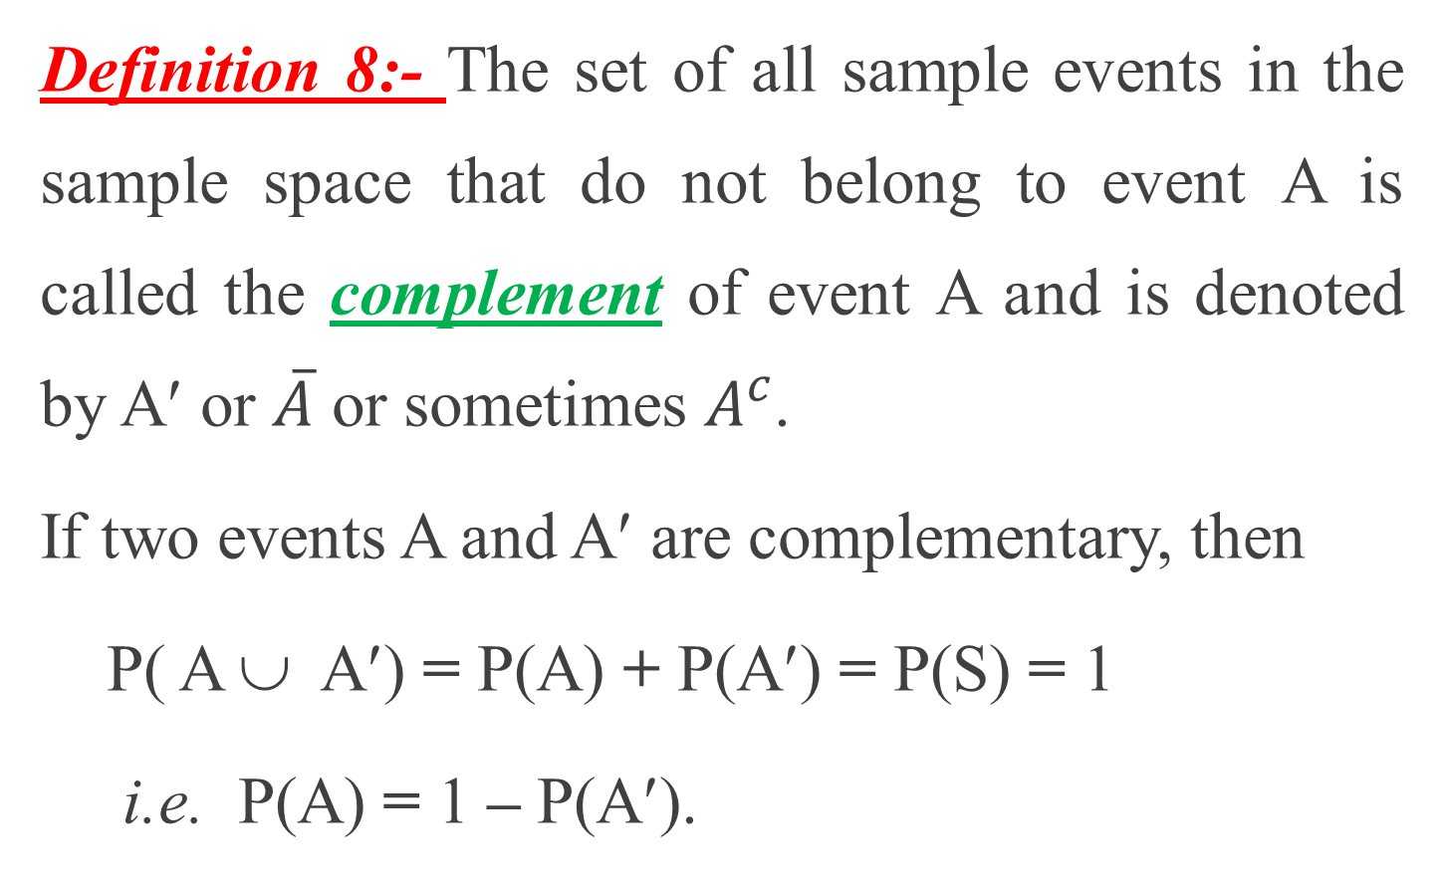
6.1 Introduction to Probability Complement of an event
Definition 8:- The set of all sample events in the sample space that do not belong to event A is called the complement of event A and is denoted by A′ or $\overline{A}$ or sometimes $A^{c}$.
If two events A and A′ are complementary, then
P( A ∪ A′) = P(A) + P(A′) = P(S) = 1
i.e. P(A) = 1 – P(A′).

Slide 32
6.1 Introduction to Probability Complement of an event
Example 9:-- Toss a coin once and find the probability that the result on top is not a head.
Example 10:- Draw a card once from a well shuffled ordinary deck of 52 cards. Find the probability that the drawn card is
(i) not a black card (iii) not a diamond
(ii) not a King (iv) not a face card

Slide 33
6.4
Dependent events, Independent events and Conditional Probability

Slide 34
6.2 Dependent events, Independent events and Conditional Probability
Definition 9:- Two events are said to be independent, if the occurrence or non-occurrence of one event has no effect on the probability of the other event. Otherwise they are called dependent events.
For events to be considered dependent, one must have an influence over how probable another is.

Slide 35
6.2 Dependent events, Independent events and Conditional Probability
For example, say you’d like to go on vacation to Bahir Dar at the end of this term , it depends on the security on the way and around the city of Bahir Dar, having enough money . . .
An event is deemed independent when it is not connected to another event, or its probability of happening, or conversely, of not happening.

Slide 36
6.2 Dependent events, Independent events and Conditional Probability
This is true of events in terms of probability, as well as in real life, which, as mentioned above, is true of dependent events as well.
For example, the color of your hair has absolutely no effect on where you learn. The two events of “having black hair” and “learning at HiLCoE” are completely independent of one another.

Slide 37
6.2 Dependent events, Independent events and Conditional Probability
Example 11:- Toss a coin twice. Define events
A and B as:
A: The first toss results a head
B: The second toss results a head
Here we can see that the result of the first toss (what so ever it is) does not affect the probability of occurrence of a head on the second toss.

Slide 38
6.2 Dependent events, Independent events and Conditional Probability (Contd. ...)
That is whether the first toss is a head or not, the probability of getting a head on the second toss is still half. Thus A and B are independent events.
Example 12:- Draw two cards turn by turn without replacement from a well shuffled ordinary deck of 52 cards. Define events C and D as:

Slide 39
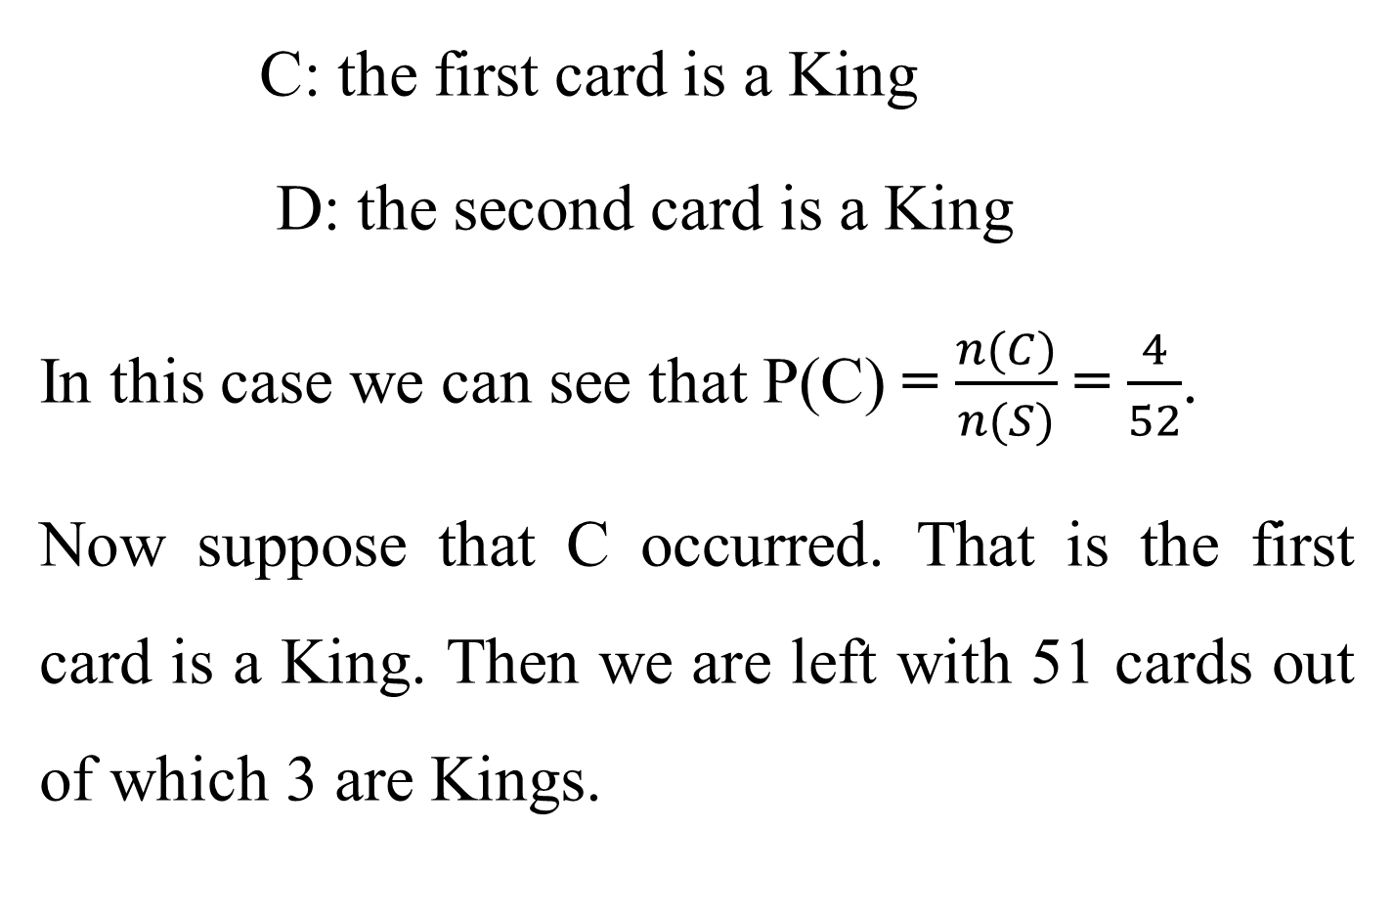
6.2 Dependent events, Independent events and Conditional Probability (Contd. ...)
C: the first card is a King
D: the second card is a King
In this case we can see that P(C) = $\frac{n(C)}{n(S)}$ = $\frac{4}{52}$.
Now suppose that C occurred. That is the first card is a King. Then we are left with 51 cards out of which 3 are Kings.

Slide 40
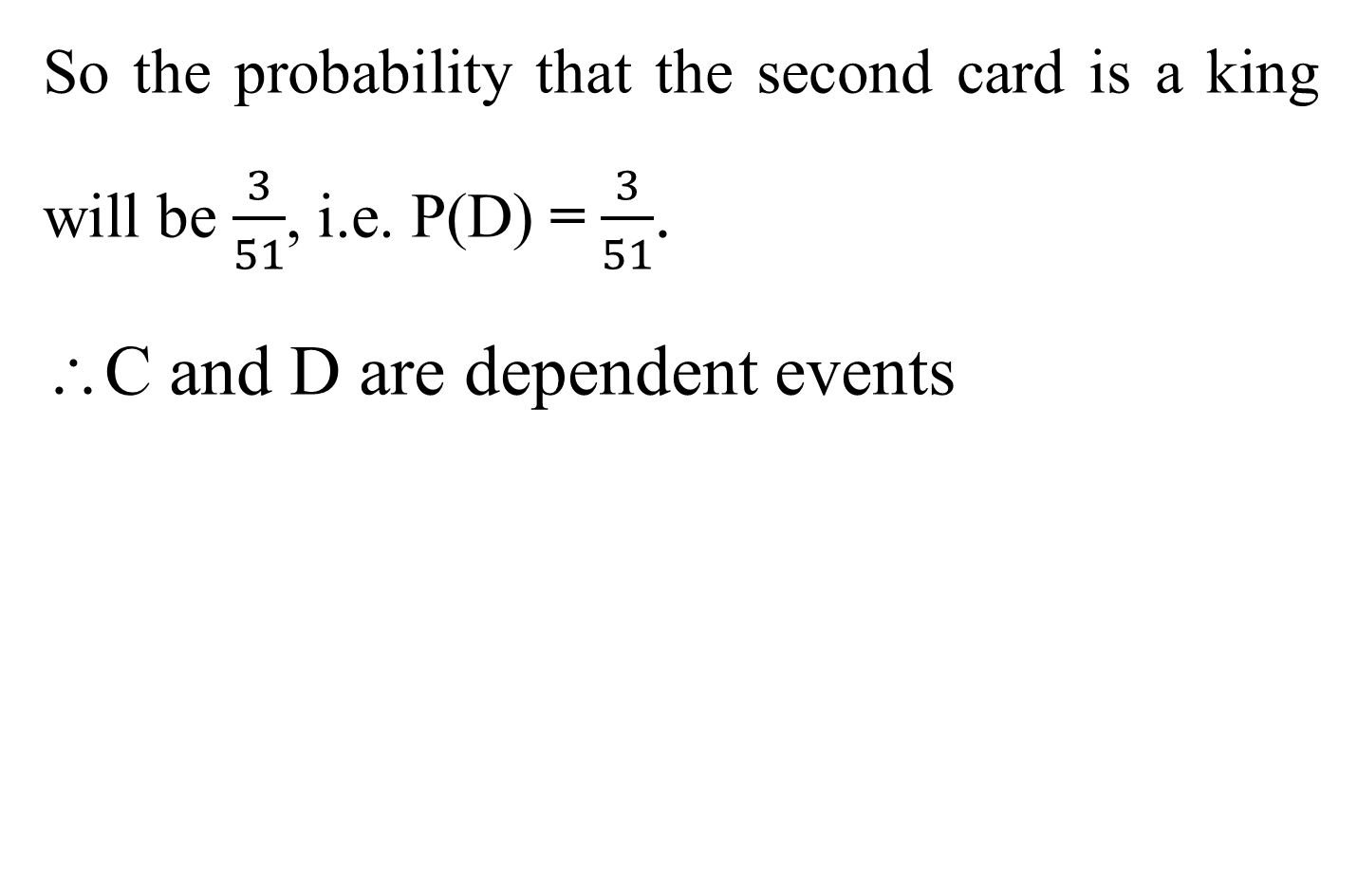
6.2 Dependent events, Independent events and Conditional Probability (Contd. ...)
So the probability that the second card is a king will be $\frac{3}{51}$, i.e. P(D) = $\frac{3}{51}$.
∴C and D are dependent events

Slide 41
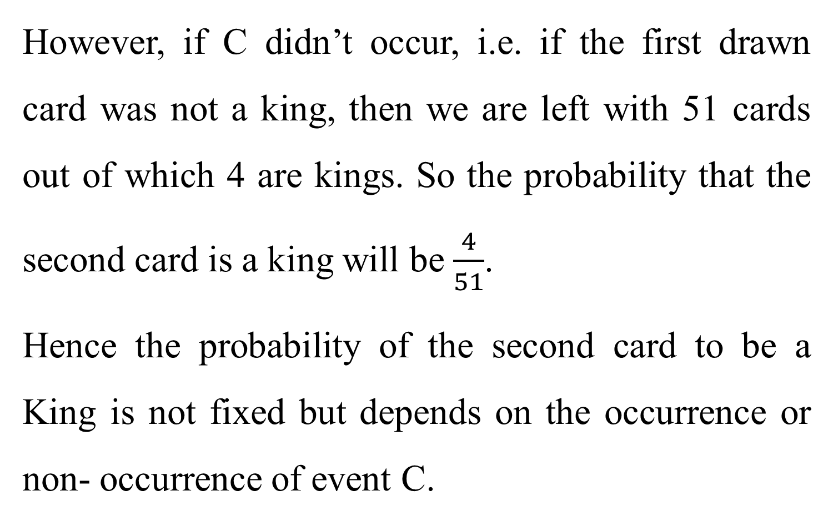
6.2 Dependent events, Independent events and Conditional Probability (Contd. ...)
However, if C didn’t occur, i.e. if the first drawn card was not a king, then we are left with 51 cards out of which 4 are kings. So the probability that the second card is a king will be $\frac{4}{51}$.
Hence the probability of the second card to be a King is not fixed but depends on the occurrence or non- occurrence of event C.

Slide 42
6.2 Dependent events, Independent events and Conditional Probability (Contd. ...)
Definition 10:- When two events are dependent, the probability of one event given that the other event has occurred is called conditional probability.
Notation:- P(B╲ A) denotes the probability of event B given that A has occurred.

Slide 43
6.2 Dependent events, Independent events and Conditional Probability (Contd. ...)
If two events A and B are independent, then the probability of getting both A and B is defined by: P(A and B) = P(A) × P(B).
If two events A and B are dependent, then the probability of getting both A and B is defined by: P(A and B) = P(A) × P(B╲ A).

Slide 44
6.2 Dependent events, Independent events and Conditional Probability
Example 12:- A bag contains 4 red, 2 green 7 blue balls. What is the probability of drawing a red ball in the second draw given that the first ball drawn is blue?
i) The balls drawn are replaced in the bag.
ii) The balls are drawn turn by turn without replacement.

Slide 45
6.2 Dependent events, Independent events and Conditional Probability (Contd. ...)
Example 13:- Flip a coin three times. What is the probability of getting a tail in all the three tosses?
Example 14:- Draw two cards turn by turn without replacement from a well shuffled ordinary deck of 52 cards. What is the probability of getting
(i) an Ace in both draws?
(ii) a Face card in both draws?

Slide 46


Slide 47


